Slide 1

Share Sunday 2023
Notes:
Opening slide before worship starts
Please have the Share Sunday brochures available for people as they enter.

Slide 2
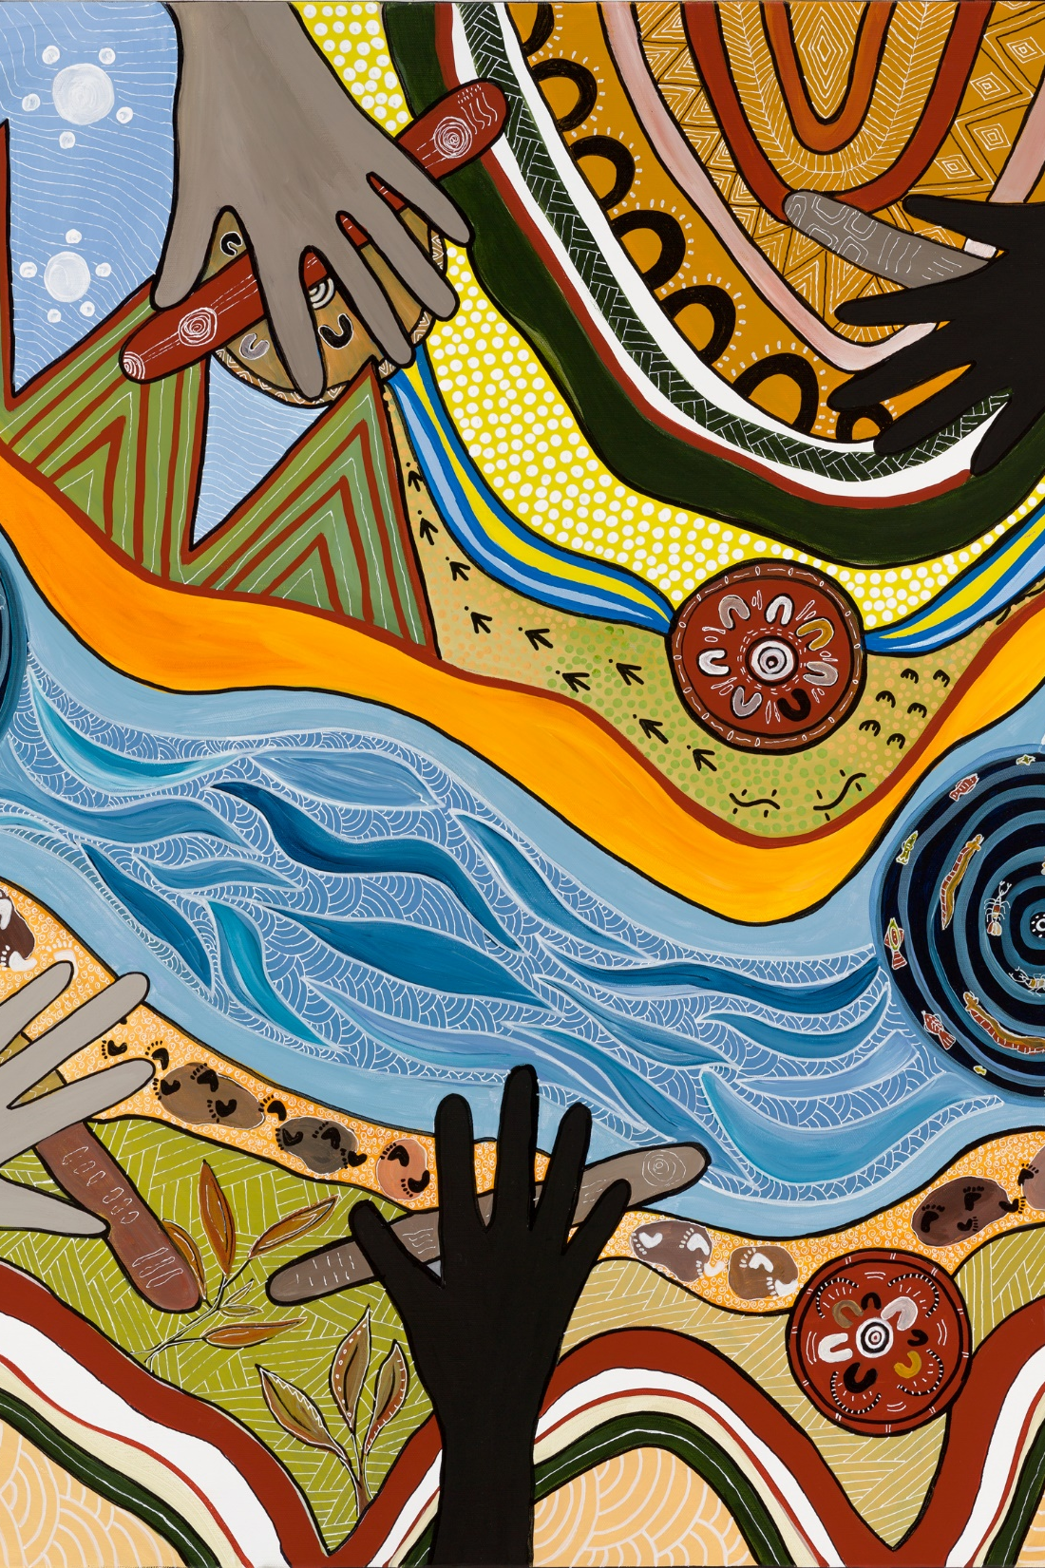
Acknowledgement of country
We acknowledge the traditional custodians of country throughout Australia and recognise their continuing connection to land, waters and culture. We pay our respects to their Elders past, present and emerging
Notes:
Acknowledgement of country, as per local custom.

Slide 3

Call to worship
(We gather together as the people of God)
God who calls all to unity
We give ourselves to be shaped by you
As we are embedded in you, you are embedded in us
We sing your praise in joyful unity.
Notes:
We gather together as the people of God

Slide 4
Opening Hymn
(Some suggestions)
TIS 690 Beauty for brokenness, hope for despair
TIS 188 Where wide sky rolls down and touches red sand
TIS 693 Come as you are, that’s how I want you
TIS 351 Lift high the cross, the love of Christ proclaim
Notes:
Let us stand as we are able to sing our opening hymn:

Slide 5

Greeting
The grace of the Lord Jesus Christ
the love of God
and the fellowship of the Holy Spirit
be with you all.
And also with you.
Notes:
The grace of the Lord Jesus Christ
and the love of God
and the fellowship of the Holy Spirit
be with you all.
And also with you.

Slide 6
‘God’s call to Unity’
What might that look like for you?
How are you responding to God’s call for unity?
How are all the relationships we build through our community services by congregation, Presbytery, and agencies reflective of God’s call for unity?
Share Sunday: 2023
Sharing hope for young people experiencing or at risk of homelessness.
Notes:
Share Sunday is an opportunity for the whole of the Uniting Church to celebrate the incredible community services being undertaken by our agencies, parish missions, presbyteries, and congregations. It is also an invitation to continue to explore how we can partner together as we respond to Christ’s calling to serve humanity seeking to create an inclusive, connected and just world. This year our theme is ‘God’s call to Unity’. What might that look like for you? How are you responding to God’s call for unity? How are all the relationships we build through our community services by congregation, Presbytery, and agencies reflective of God’s call for unity.

Slide 7

Announcements/News
Notes:
An opportunity to share local news and announcements line with your local custom

Slide 8
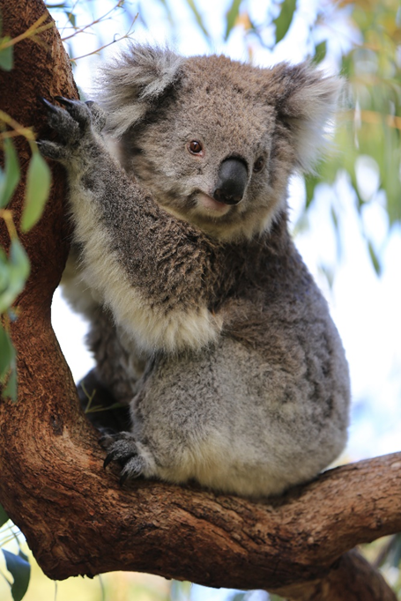
Opening Prayer
God, of the broken heart,
And for a broken world,
We come seeking your presence
To dry our tears,
Share our joys,
To hold us close
And for your dream to rise again,
In us and through us.
Notes:
Opening Prayer

Slide 9
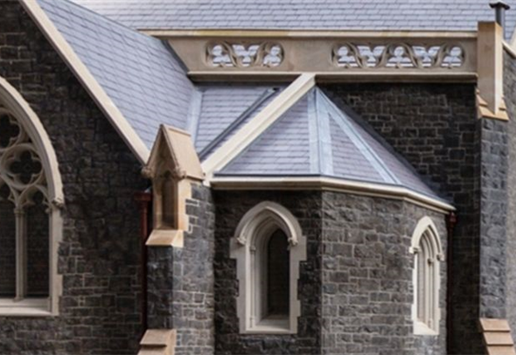
Prayer of confession
God of everlasting hope and mercy,
We weary you with our excuses,
Our petty jealousies,
Our long-held grudges,
Our self-righteousness and supposed superiority.
May our hearts be broken like yours is broken
May your cleansing tears flow through our lives
May the boat of our ego be lost in the depth of your sea
May your tender heart be found in us.
Notes:
Prayer of Confession

Slide 10
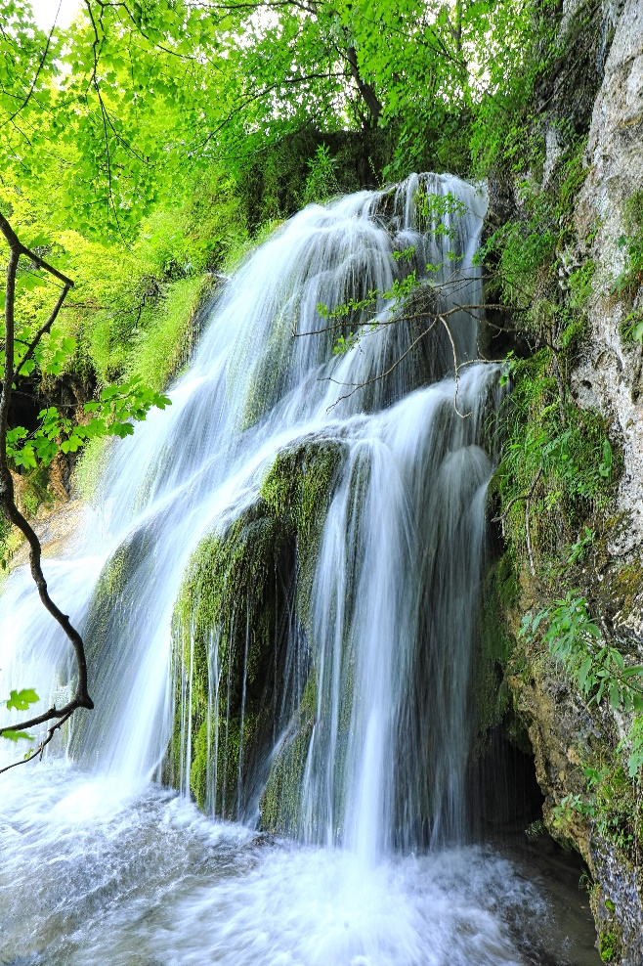
Declaration of forgiveness
Hear the Good News of our shared faith:
A bruised reed, God does not break
A dimly burning wick, God does not snuff out;
From God’s broken heart you are made whole,
God’s tears become for you a cleansing stream,
For in Christ God says
“Your sins are forgiven”
Thanks be to God
Notes:
Declaration of Forgiveness

Slide 11
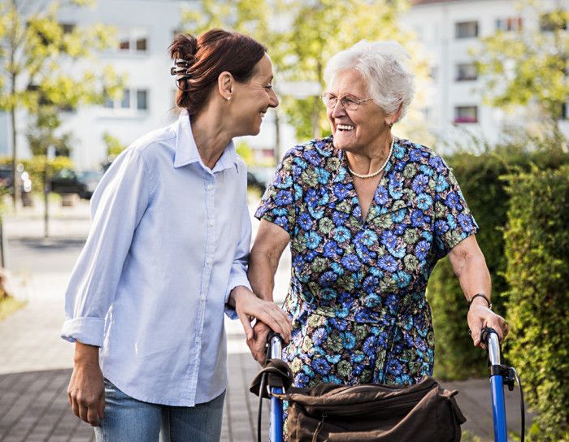
The Peace
The peace of the Lord
be always with you
And also with you.
Notes:
(if your congregation passes the peace, and in line with the current health guidelines
continue with:
The peace of the Lord be always with you
And also with you.
and invite people to exchange a sign of peace with one another)
The peace of the Lord be always with you
And also with you.

Slide 12
Thanksgiving Song or Hymn
(Some suggestions)
TIS 685 The power of your love
TIS 693 Come as you are
TIS 717 Give thanks with a grateful heart
TIS 738 Shout to the Lord
Notes:
Let us stand as we are able to sing our opening hymn:

Slide 13
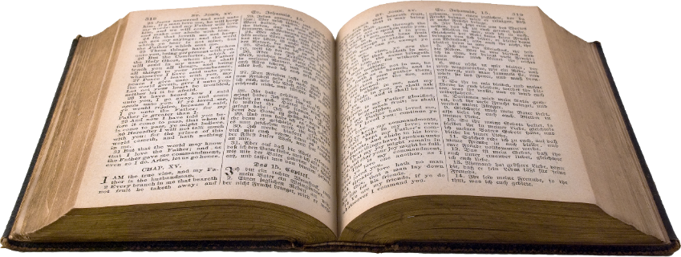
Scripture Readings:
Genesis 45:1-15 Joseph forgives his brothers
Unity within the family
Ps 133 How blessed is unity
Unity within the nation
Romans 11:1-2a,29-32
Jew and Gentile reconciled – God’s mercy on all
Unity between ethnicities
Matthew 15: (10-20), 21-28
The Canaanite woman
Jesus’ conversion to a greater unity
Notes:
(Any scriptural quotations are from the New Revised Standard Version Updated Edition – NRSVUE)
(The Revised Common Lectionary for Sunday 20th August 2023, Pentecost 12)

Slide 14
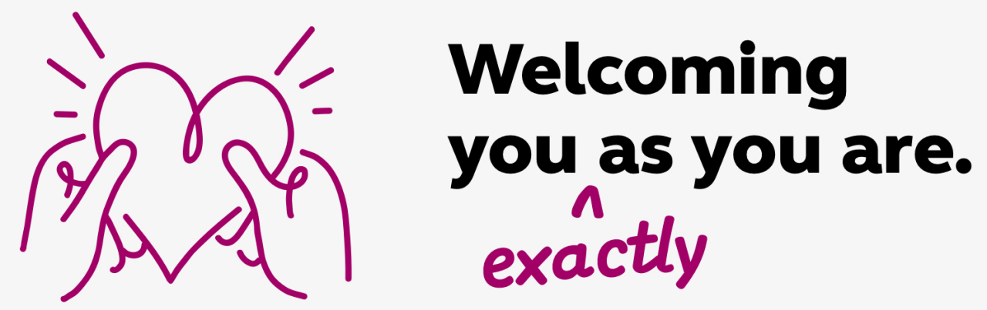
Early Word & Activity
All are Welcome
Notes:
This an opportunity for an intergenerational activity and conversation around the Question
“How can we respond together to God’s call for unity?”
Choose one of today’s texts to focus on.
The lectionary readings for today describe an ever-widening call for unity.
Hand out the Activity Sheet provided in the resource pack and encourage everyone to work together in pairs/small groups to complete the activity sheet. Encourage a mix of generations.
Invite contributions in words, drawings, sculpture, mime!
Share in small groups and report back to whole gathering if appropriate.
Another question for reflection:
What might be some of the challenges if your group cannot agree on a common purpose, and/or a common set of values?
Close with prayers of thanks for the unity of God, Creator, Redeemer and Life-giving Spirit, overflowing in our lives and communities.

Slide 15
Hymn
TIS 690 Beauty for brokenness
Notes:
Let us stand as we are able to sing:

Slide 16

Sermon/Reflection
Notes:
There are some sermon/reflection materials in the resources pack for the core reflection time, including some information on current statistics, information about some programs, and stories of how fractured communities and lives are being healed and divisions overcome.

Slide 17
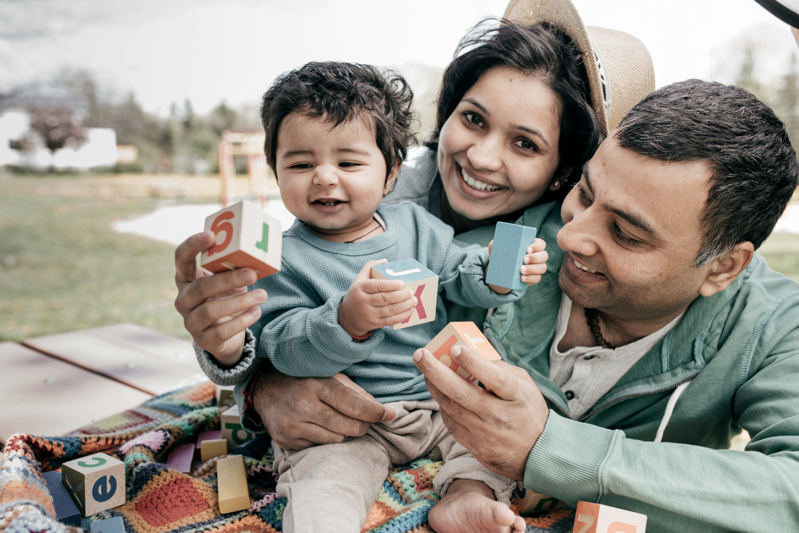
Asylum Seeker Welcome Centre – Brunswick
Notes:
Unity through solidarity - 20 years of welcoming
Since August 2002, Uniting’s Asylum Seeker Welcome Centre (ASWC) in Brunswick, despite divisive social and political climates, has stood firm as a place of refuge, unity and humility.
While waiting for decisions on their applications to be recognised as refugees, many asylum seekers are isolated in the community with very little or no form of assistance and with few rights or entitlements. With the support and collaboration of congregations like: Coburg, Warrandyte, Camberwell and Brunswick we have come together in Unity with the ASWC to help ensure asylum seekers feel safe, welcome and part of the community.
Uniting's Asylum Seeker Program Team Leader, Aimee says the centre supports people at all stage of their settlement journey.
"The centre provides a dual service in responding to people's basic needs and empowering people to learn how to navigate the Australian context," she said.
"It is important to understand where people are at in their settlement journey.”
From English programs to digital literacy or piano lessons to employment workshops, the ASWC offers a myriad of programs to better prepare asylum seekers for life in Australia.
And beyond practical support, the centre also provides emotional support. The migrant experience is known to be a complex one.
“It might be sitting with someone while they cry for 10 minutes or smiling at someone and you’re the only person they have talked to that day. Being reminded of that role that we have in people’s lives and that the connection is meaningful for them,” Aimee said.
Aimee expressed her gratitude to congregations for their long-standing support of the program, “congregations have always been behind the work we do. Their commitment to advocating for justice and supporting those seeking asylum is truly inspiring.”

Slide 18
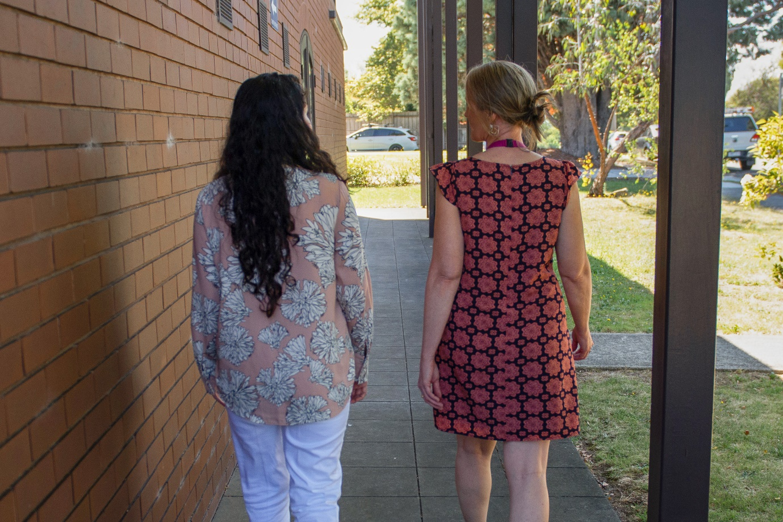
Winter Appeal – Nancy
Notes:
Unity through partnerships – putting faith into action
Some of you may remember Nancy* from our Winter Appeal.
A year ago, Nancy found herself on the edge of crisis. “One day I saw I'm alone. Really alone,” Nancy reflected. “I didn't know where to go, what to do. I just thought I can’t continue.”
As a new migrant in Australia, Nancy had travelled all the way from Iran in search of new beginnings. However, life was not as she had dared dream.
While grappling with the grief of losing her mother, Nancy was forced to leave a violent marriage. Alone in a new country she was suddenly without stability, support or safety.
“You make some plan for yourself before leaving your country,” said Nancy. “Everyone makes that plan. But then you realise everything is completely different. Not what you expected.”
Although Nancy has limited memory of that dreadful day, she fortuitously found herself one afternoon at the doors of Uniting’s emergency relief centre in Melbourne’s east.
“I went to Uniting by accident,” said Nancy. “I was in tears, crying. I just remember after that, everything happened very quickly.” “They helped and they put me [on the path] to a normal life.”
Nancy was supported into crisis accommodation and then offered transitional housing. This accommodation is a partnership of the local congregation and Uniting Vic.Tas; the realisation of a shared vision.
The Uniting program offers women who are at risk of homelessness and have experienced family violence, a safe haven while they set about securing a long-term home. Women also receive help with finances, mental health, food relief, employment coaching and other support services.
The local Uniting Church congregation advocated for and carefully planned the specialist accommodation. Congregation members generously donating their time to help prepare a joint funding application with the Wesley Mission, now Uniting Vic.Tas, to the Victorian Government.
For more than two decades, congregational members continued to lobby governments to realise their missional purpose on the Church’s excess land.
Today Nancy is now living in her own apartment and completing a degree in data analysis.
“The good people in my life were Uniting. Honestly, even all the Australian people. They all had some role in my journey. They helped me a lot,” said Nancy.
*This is a true story about a real person. Some details such as names have been changed to respect the wishes of the person featured.

Slide 19
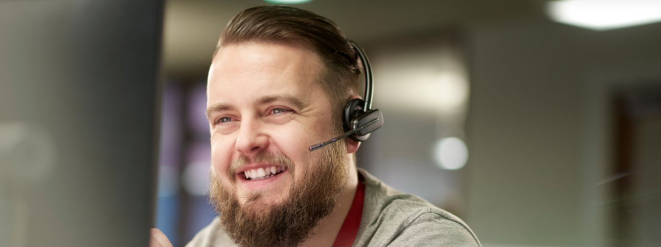
Lifeline - Prahran
Notes:
Unity in allyship - compassion and a listening ear
Anthony volunteers as a Crisis Support worker for Uniting’s Lifeline in Prahran.
He supports people over the phone who may be facing a mental health crisis, and those who call asking for advice about a loved one or friend in trouble.
“I truly feel that I am making a difference,” said Anthony.
“My role is to be their ally, to let them know that they are not alone, to acknowledge what they are going through and how it impacts them.
“So many times, people just need to feel listened to. They need to have someone else ‘get it’ and acknowledge the hardship they are feeling.”
Anthony stresses that mental health impacts more than the individual.
“Suicide and depression are huge burdens on not just the individual but also their family and friends,” he said.
“So, being able to play a role where we can alleviate that, we are not only just going to be helping the caller but also their family and friends as well.”
Since volunteering, Anthony has found his outlook on life has shifted.
“This role gives me a lot of perspective on people and keeps me centered. It serves as a reminder to feel grateful for what I have, and to equally recognise when to call out for help.
Anthony explains that mental ill health doesn’t discriminate.
“Mental illness affects everyone and at every age,” he said.
“Feelings of loneliness, isolation and fear are often the key characteristics that drive depression.
“Almost all of us face significant challenges and hurdles sometime in our lives. These can weigh us down impacting not just our own health, but the health of our family and friends who love us.
“Lifeline volunteers are there to form that connection with you. To listen. To hear you without interruption or judgement. To be your ally, to empower you.
“Connecting with someone and helping them to realise they do matter to the world, can be an incredibly empowering and enriching experience for the soul.”
Uniting Vic.Tas is a trusted delivery partner of Lifeline Australia in Melbourne and Ballarat.
Uniting’s Ballarat service began operating in 1971. The service was a developed vision set forth by a band of keen volunteers from the Uniting Church. Today over 1,000 volunteers have helped people in crisis in the Ballarat community over the last 50 years.

Slide 20
Hymn
(some suggestions)
TIS 618 What does the Lord require?
TIS 607 Make me a channel of your peace
TIS 640 Kneels at the feet of his friends
TIS 474 Here in this place a new light is streaming
Notes:
Let us stand as we are able to sing:

Slide 21
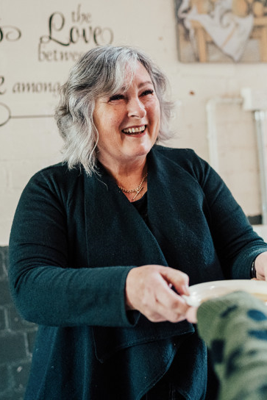
Offering
Broken-hearted God with you we cry for the world;
With you we give our lives for the unity of family, church and world.
Bless and multiply these gifts,
so that divisions are healed
and the world rejoice in your gift of unity.
To the glory of you name.
Amen.
Notes:
The path to unity within ourselves, our church, and the world, is a never ending task;
yet by the spirit of Christ we are emboldened and strengthened,
so we bring our offerings and lives,
to be dedicated again to collaborate with God
in the reconciliation and renewal of all.
We make our offering.

Slide 22
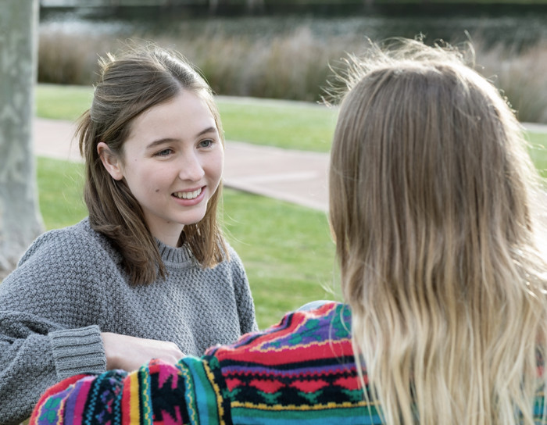
Prayers of the people
In this prayer the words ‘Lord in your mercy’ are followed by the response ‘may the love of Christ in us bring healing to a fractured world’.
Unifying Spirit of Christ
We pray that our false unity be laid bare
That our clinging to peace at all costs
And our desire for uniformity
Is torn apart and stitched together
by your celebration of diversity
Notes:
Prayers of the people
You may choose to not include the liturgist prayer, but just the responses.

Slide 23
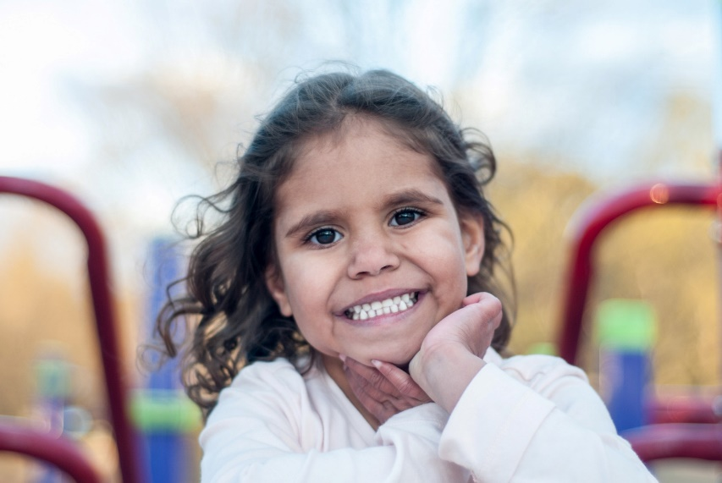
Prayers of the people
Loving God
We know you through your promise to be always with your people,
leading us ever deeper into the hope for renewed and abundant life.
We pray for the many people who are displaced in our world for whom the promise of a place to call home seems an impossible dream.
Help us to have the courage to see the need in our world o listen to the voices calling out for changeo act in solidarity for the transformation of our world
We pray for your church, a community called to be a place of welcome
to all who seek a place to belong
Help us to be faithful stewards of your promises,
A people who because they have received so much
Know that they have so much they can share.
We are aware that the blindness of our desire for uniformity and fear of difference
Caused storms of terror and unending clouds of grief for First Nations peoples
May their corroborees celebrating their songlines
Vibrate throughout the land
May we be caught up in their dance and song
May the land heal, may the people lament
Until Voice, Treaty and Truth is established in this land
Lord in your mercy: may the love of Christ in us bring healing to a fractured world
Notes:
First Nations Peoples

Slide 24
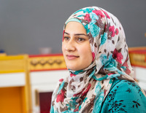
Prayers of the people
Mostly on planes they come, flying in with money in their pockets, seeking asylum, and they are welcomed
Mostly on boats they come, impoverished, desperate, selling all they have for a boat to freedom
And we imprison them, indefinitely, breaking their spirits
O God, ravish our desperation for security and wealth
Grow in us kind, gentle and courageous hearts
Extravagant with the love of God
May we dance the intercultural dance of diversity
Until we lay exhausted with happiness in finding our true self
by embracing the stranger crying for help.
Lord in your mercy: may the love of Christ in us bring healing to a fractured world
Notes:
Refugees

Slide 25
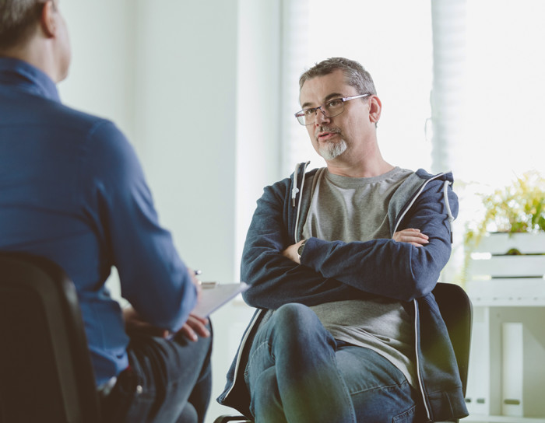
Prayers of the people
O God, we know the fracturing of our own minds and spirits
In the face of the stress of contemporary life
We pray for those whose minds are not their own
Minds that speak and shout obscenities and confusion
May they find unity of thought and purpose
As wise and kind people come beside them
So friendships, therapies and medications can heal
Lord in your mercy: may the love of Christ in us bring healing to a fractured world
Notes:
Mental Health

Slide 26
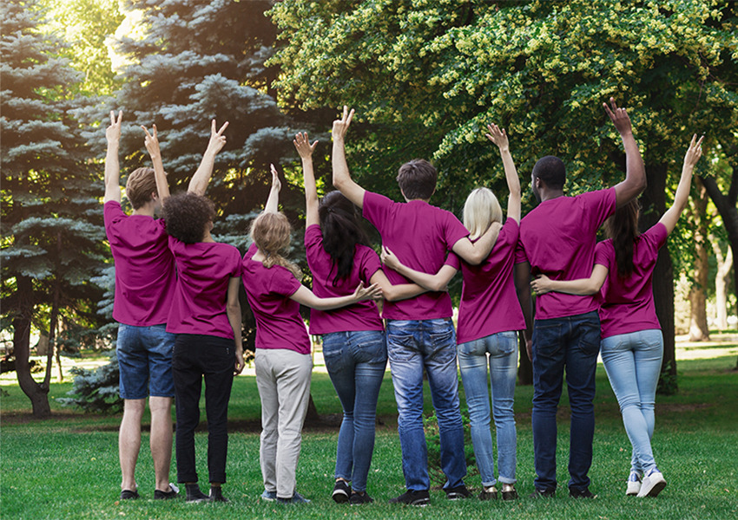
Prayers of the people
Mother earth is fracturing, her atmospheric cloak is shredding,
Her systems are unbalanced, and we totter with our opinions
on our lemming like march to destruction.
May the light of sanity dawn, the long view become clear
So we are prepared to make the sacrifices required
for the mending of our one and only common home.
Lord in your mercy: may the love of Christ in us bring healing to a fractured world’
Notes:
The environment

Slide 27

Prayers of the people
What is this economy we have created
With rules that favour those who have -
Those who already have houses and are able to finance more;
Those who have more than they need,
so their surplus continues to accumulate.
All at the expense of those who have less.
Lay bare the myths we tell of their laziness
Our smug self satisfaction
Bring unity of common values and common purpose
So that all have a home,
all have networks of encouraging friends
all have access and ability to learn and work with gladness.
Lord in your mercy: may the love of Christ in us bring healing to a fractured world’
Notes:
The economy

Slide 28

Prayers of the people
God you are the unity of Creator, Redeemer and Life giving Spirit
Laughing and weeping, dancing and falling
Ever generous, and ever one.
May your church on earth be healed of all divisions
Lay down its holding on to its own truth
Be released into the reality of your love for diversity,
And walk again the path of the service and love.
Lord in your mercy: may the love of Christ in us bring healing to a fractured world’
Notes:
The Church

Slide 29

Our Father in heaven
hallowed be your name,
your kingdom come,
your will be done,
on earth as in heaven.
Give us today our daily bread.
Forgive us our sins
as we forgive those who sin against us.
Save us from the time of trial
and deliver us from evil.
For the kingdom, the power, and the glory are yours now and forever. Amen.
Notes:
We conclude our time of prayer with the words Christ taught us, we pray:
Our Father in heaven
hallowed be your name,
your kingdom come,
your will be done,
on earth as in heaven.
Give us today our daily bread.
Forgive us our sins
as we forgive those who sin against us.
Save us from the time of trial
and deliver us from evil.
For the kingdom, the power, and the glory are yours
now and forever.
Amen.

Slide 30
Closing Hymn
(Some suggestions)
TIS 547 Be thou my vision
TIS 658 I the Lord of sea and sky
TIS 650 Brother, sister, let me serve you
TIS 674 Inspired by love and anger
Notes:
AS we prepare to be sent out into the world, please stand as we sing our final hymn

Slide 31
Word of mission & blessing
The rolling rollicking world, on the sea of its own making,
Is calmed by the love of God, made daring through the courage of Christ, and transformed by the ever-calling Spirit – so now go in the love of God.
We go in the unity of God, delighting in diversity, embraced by Christ, steadfast in purpose.
Amen!
Notes:
We share in the responses in bold.

Slide 32
We sing our final blessing…
Notes:
As per your local custom

Slide 33
Thank you for
SHARING
Learn More vt.uniting.org
Notes:
You may want to include an invitation to hospitality if that is something you offer after worship.
Please mention that the Share Sunday brochure is available for anyone who wants one.

Slide 34

Community Support
If today’s theme stirs something for you, you may choose to talk with someone you trust, an elder, your minister or refer to one of these help lines
Lifeline www.lifeline.org.au 13 14 11
Beyond Blue www.beyondblue.org.au 1300 224636
Kids Helpline www.kidshelpline.com.au 1800 551800
MensLine www.mensline.org.au 1300 789978
Open Arms www.openarms.gov.au 1800 011046
(Defence Forces)
Butterfly Foundation www.thebutterflyfoundation.org.au 1800 334673
(Eating Disorders)
Notes:
If today’s theme stirs something for you, you may choose to talk with someone you trust, an elder, your minister or refer to one of these help lines

